Slide 1
Deep Neural Networks for Acoustic Modeling in Speech Recognition
http://cs224d.stanford.edu/papers/maas_paper.pdf

Slide 2
Objectives
Understand the building blocks, past work of speech recognition
Learn about related ML for speech recognition
Understand successful algorithm used

Slide 3
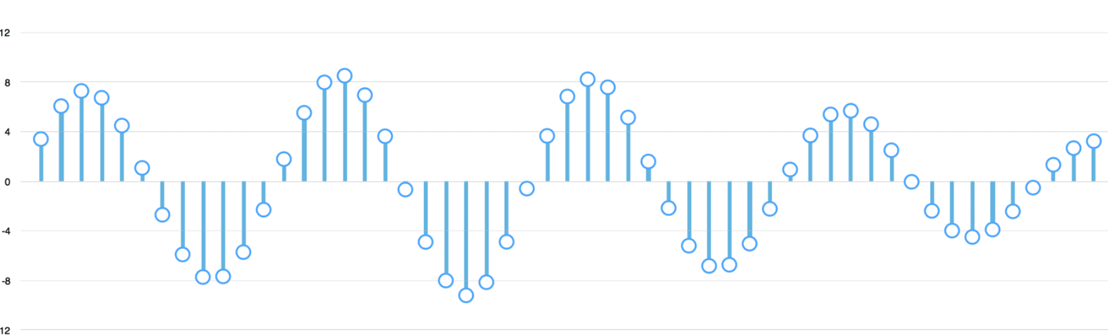
Encoding and Time Stretching
Sound waves to numbers using sampling
Dealing with speed differences
Hello vs HHHEEELLLLOOOO
Closely related: Dynamic Time Warping
Source: Medium article

Slide 4

Speech Training
Audio
Phones
Words
Start | End | Phone
0 | 3050 | h#
3050 | 4559 | sh
4559 | 5723 | ix
5723 | 6642 | hv
6642 | 8772 | eh
8772 | 9190 | dcl
9190 | 10337 | jh
10337 | 11517 | ih
11517 | 12500 | dcl
12500 | 12640 | d
12640 | 14714 | ah
14714 | 15870 | kcl
15870 | 16334 | k
16334 | 18088 | s
18088 | 20417 | ux
20417 | 21199 | q
21199 | 22560 | en
She
Had
Your
Dark
Suit
In
Greasy
Wash
Water
All
Year
Source: TMIT
Other common datasets: news, youtube

Slide 5
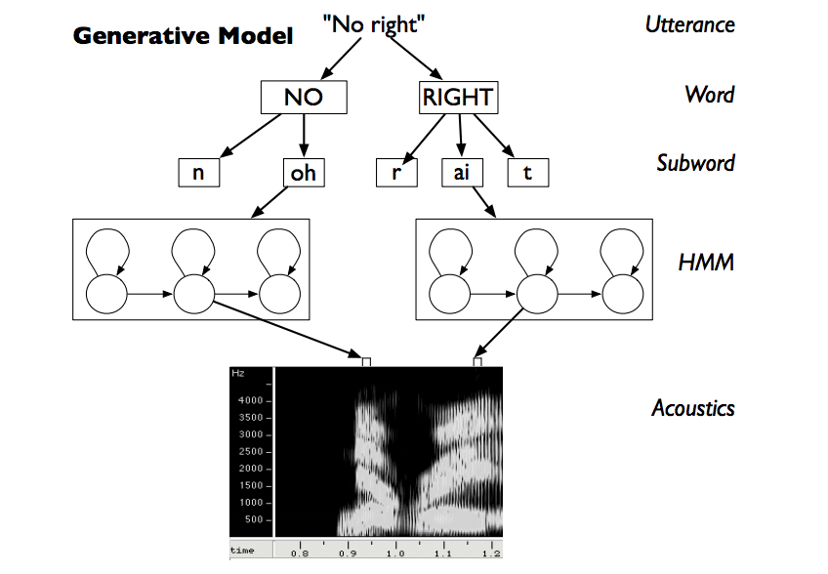
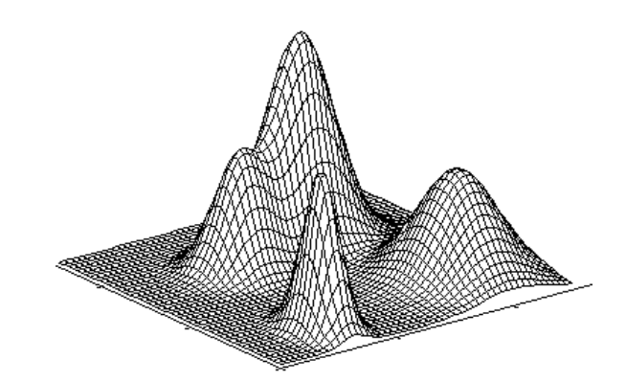
Hidden Markov Model, Gaussian Mixture Model
Assume there are a number of unknown states (X’s), attempt to find how they influence visible
“many researchers, [13], have noticed that the state transition probabilities have a negligible impact on the recognition rate and are often ignored.”
Becomes unnecessarily complex; higher degree of complexity than in voice
http://isle.illinois.edu/sst/pubs/2001/omar01asru.pdf

Slide 6
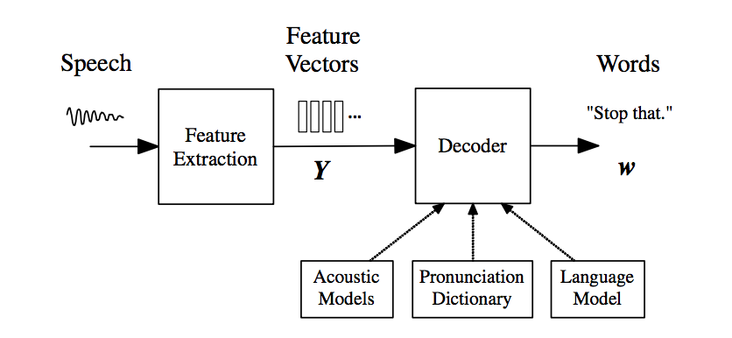
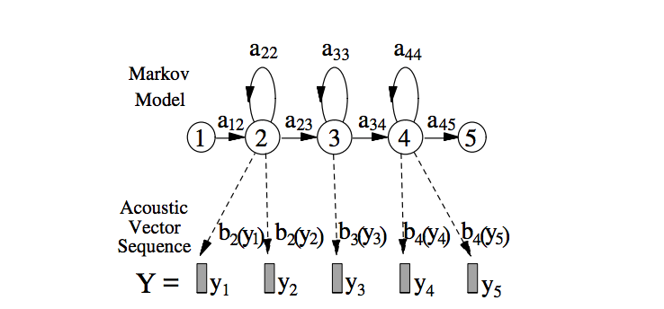
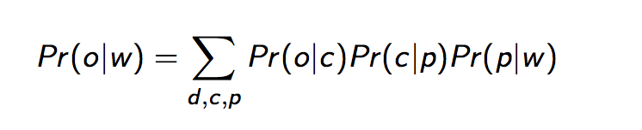
Hidden Markov Model, Gaussian Mixture Model
A Sample Decoder Algorithm:
Probability of observation given word
Probability of observation given CD model
Probability of CD model given phones
Probability of phones given word
Source: NYU

Slide 7

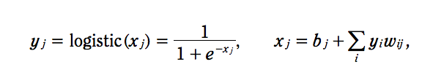
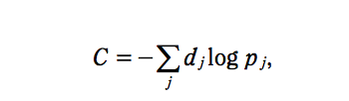
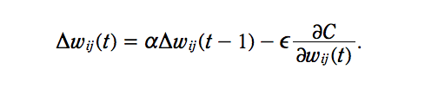
Training Deep Neural Nets (DNN)
A DNN is a feed-forward, artificial neural network that has more than one layer of hidden units between its inputs and its outputs
Logistic neurons allow nonlinearity
Softmax: probability for all outputs
Cost function compares current probabilities to expected
Propagate cost derivatives backward
New:
For initial training cases, change weights by smaller amount 𝛼 to prevent large oscilation
When we increase some weights, we reduce others. Now we reduce in proportion to w² to reduce overfitting
Initialize to small random values
source

Slide 8
Pretraining
Train a stack of RBM’s in a way which allows it to be possible to reconstruct the original data.
Similar to autoencoder networks which, for linear neurons, are PCA
Convert each datapoint into a code from which it is easy to approximately reconstruct the datapoint.

Slide 9
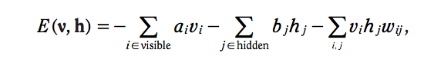
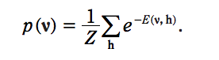
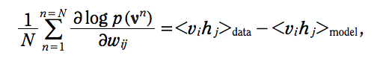
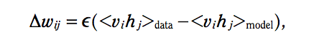
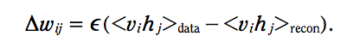
Training RBMs
v
h
Energy associated with each visible and hidden pair
Probability is a function of the energy
Take a derivative of probability wrt weights allows us to see how weights change with every new data point compared to the existing model
Faster training: “Contrastive Divergence”
Use the model to reconstruct the visual, and use the difference as your cost function

Slide 10
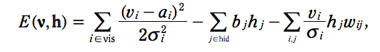
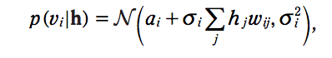
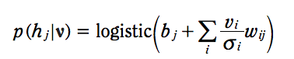
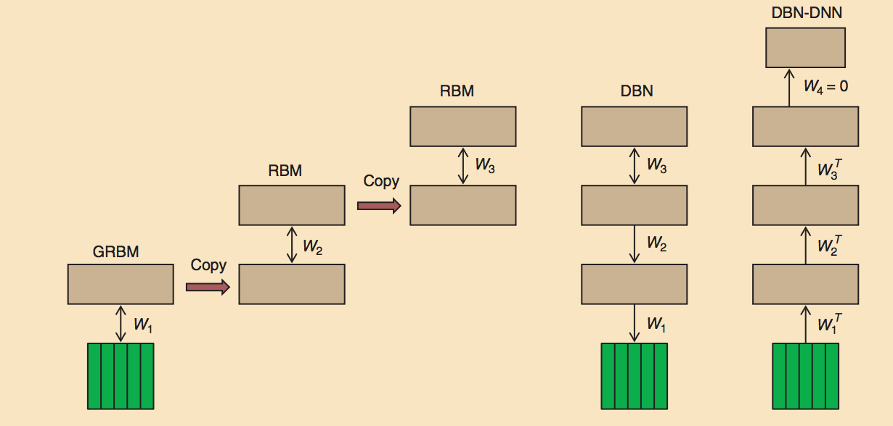
Modelling Real-Valued Data, Stacking RBMs
Gaussian-Bernoulli RBM
Sigma’s are std dev for noise in visible units
Visible probabilities are normal distributions, but hidden are not
Train DBN-DNN
Represent data with GRBM
Hidden distributions used for RBM
Add a softmax layer to predict output
Deep Belief Net – Deep Neural Net

Slide 11
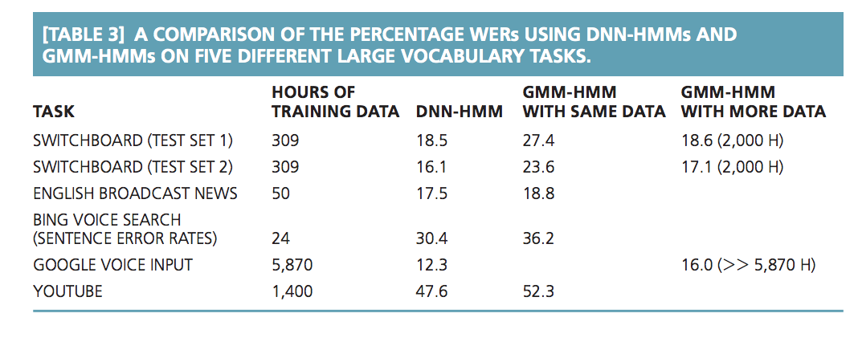
Applications
Tran scripting phones
Included max-pooling, convolutional layers
Less than half the error rates vs others
Some difficulty with parallelism vs HMM
Providing inputs to GMM-HMM

